Slide 1

DESIGN FOR SOCIAL IMPACT-1
MENTOR- Syed Nawaz pasha
19K41A04A9– Shiva Priya
19K41A0589 – Sravani. V
19K41A0219– Roshni .A
19K41A0497– Nihal Raj .D
19K41A0138– Sai Sri

Slide 2
INTRODUCTION
What is DSI –I?
Design for social impact is the practice of interrogating system institutional, economic, social, political, interpersonal in order to define opportunities for change that give voice to those who has been disenfranchised or marginalized by design. Agriculture plays a critical role in the entire life of a given economy. Agriculture is the backbone of the economic system of our country. In addition to providing food and raw material, agriculture also provides employment opportunities to a very large percentage of the population so we have choosen agriculture to help the farmers from our side by providing something which is useful to them

Slide 3
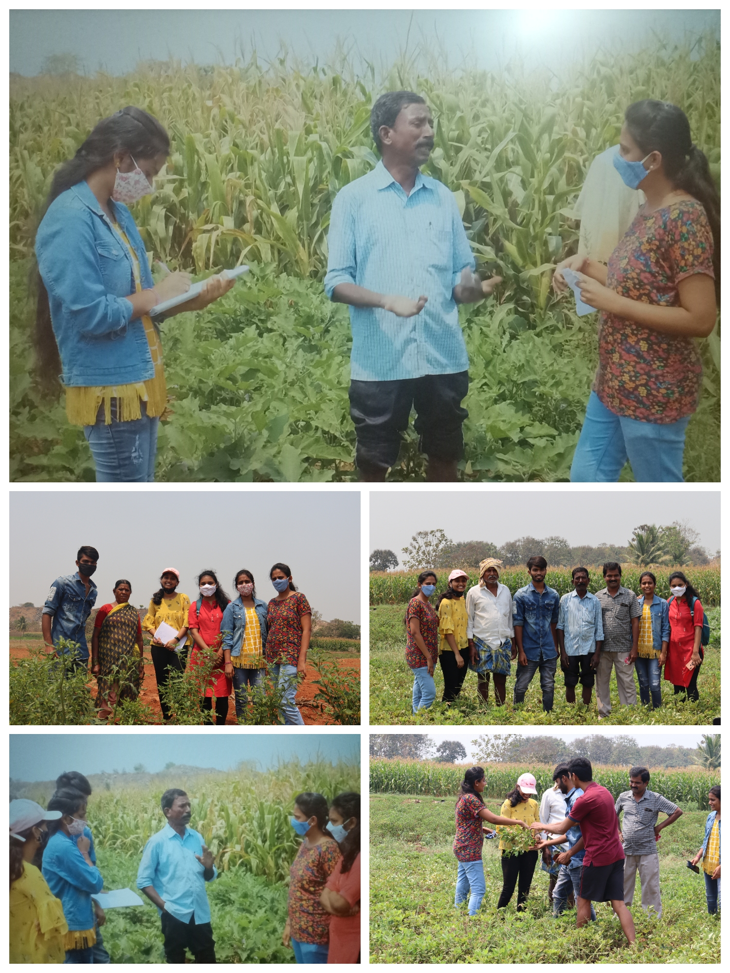
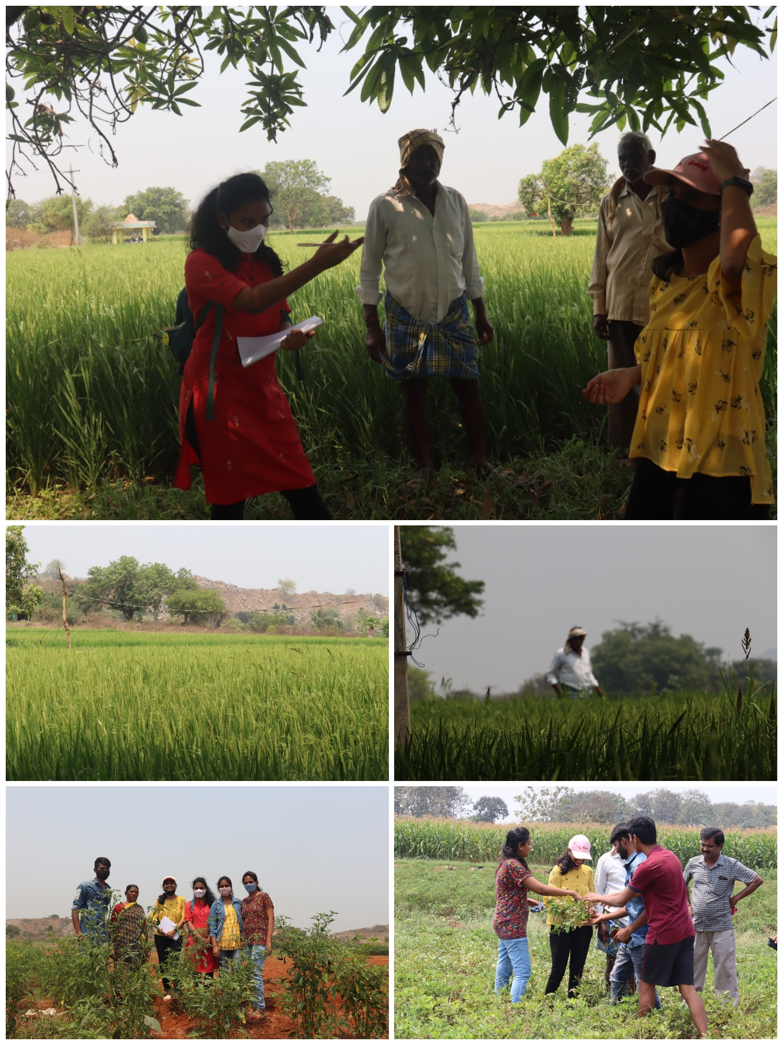
FIELD WORK:

Slide 4
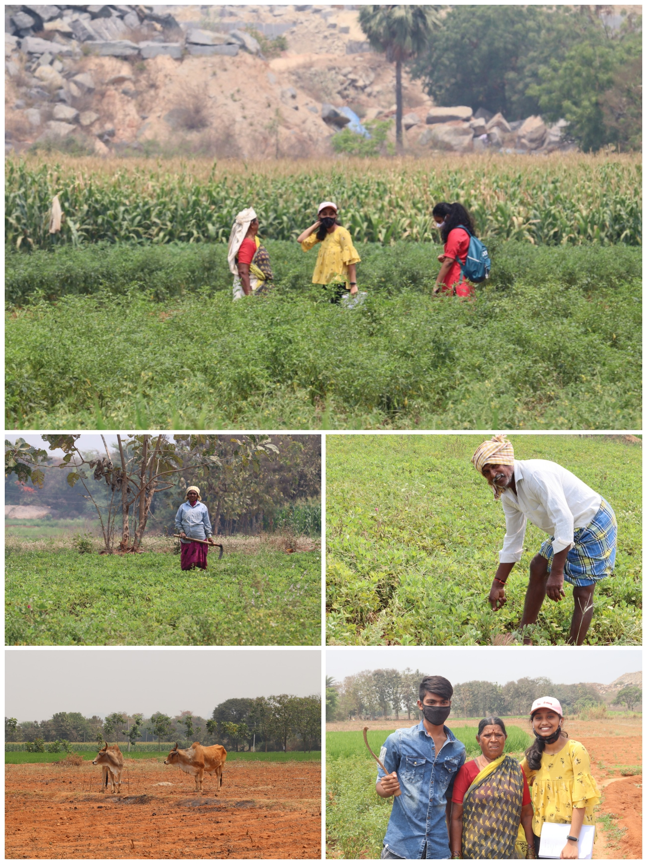
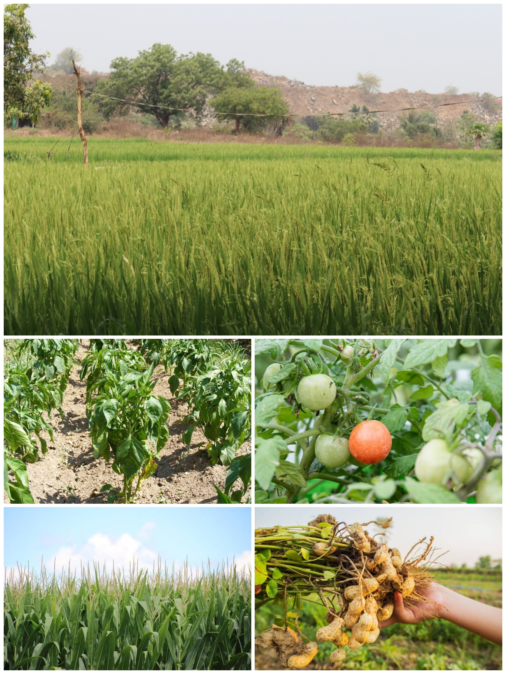
FIELD WORK:

Slide 5
SURVEY REPORT:
Place visited:
Village :-vanamala kanaparthy
We have visited around 5 farmers along with the sarpanch of the village.
Data gathered:
On interacting with the farmers of vanamala kanaparthy we go to know the details of the work they do, and these are questions asked by us during the interaction:
Do you have enough land to satify the needs of your family?
Is there any lack of labour in your area?
What is the wage you will be giving for labour per day?
Are in need of a good machionery(product) aside of good labour?
Is this area in lack of electricity?
What are the problems you are facing through electricty in farming?

Slide 6
SURVEY REPORT:
Is there any water shortage? What are the major work requirements you should do for growing the crops?
What are the problems you will face cropping multiple crops?
Is there any alternative source of income for farmers?
How do you care for the crop for good yield?
Will you face any lack of transparency in food production and distribution?
What kind of sprays ,pesticides and biocides you use?
What are problems you face after pesticide?
How many times do you frequently pesticide the crop?
How do you save your yield during the growth of the crop?
What problems do you face while you sell the crop in market?
Will the money be satisfied for your work?

Slide 7
PROJECT OPPURTUNITIES:
After the successful interaction with farmers we underwent few of the technical and biological problems they do face. And found some of the solution opportunity to clear them.
The opportunities are:
Farmers are in need of a good machionery rather than a good labour.
Farmers are facing electricity issue for the production of water.
Farmers even have shortage of water.
Problems faced to crop multiple crops.
Pesticide the crop.
Protection of crop from the external enviromental or technical problems.
Earning a good profit in the market.

Slide 8
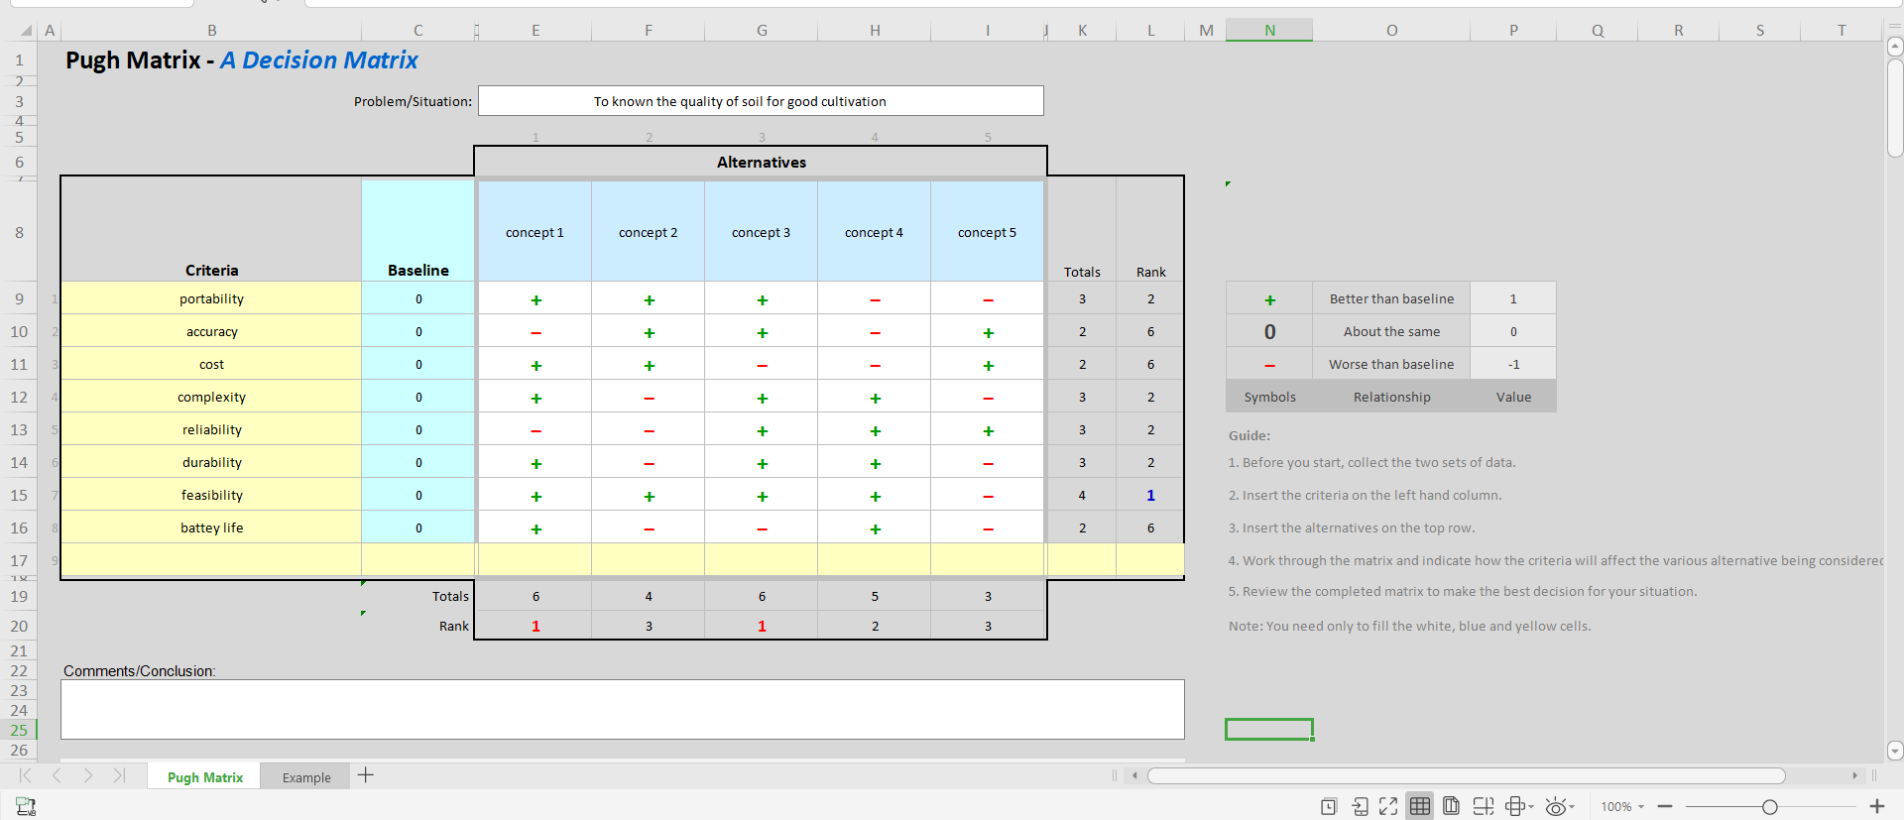
PUGH’ MATRIX:

Slide 9
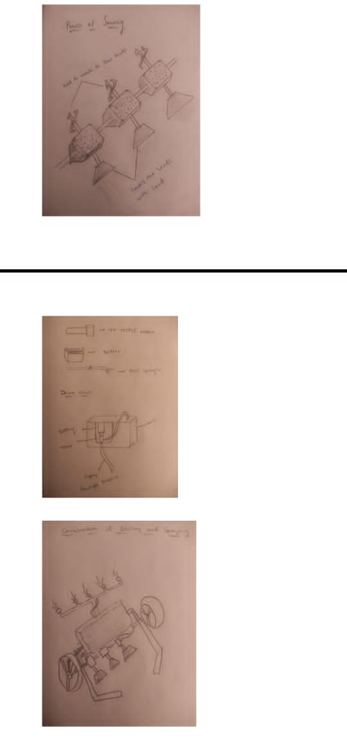
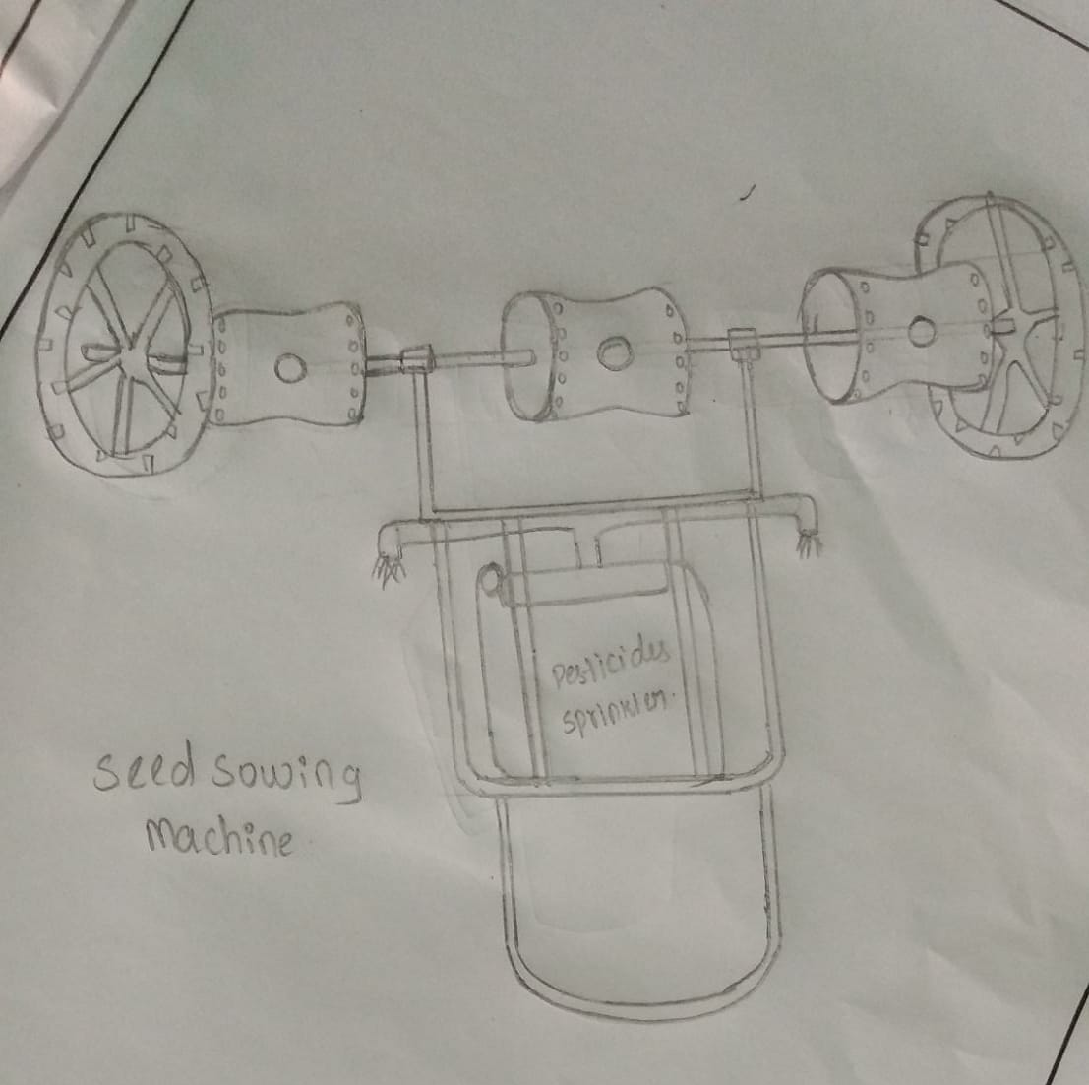
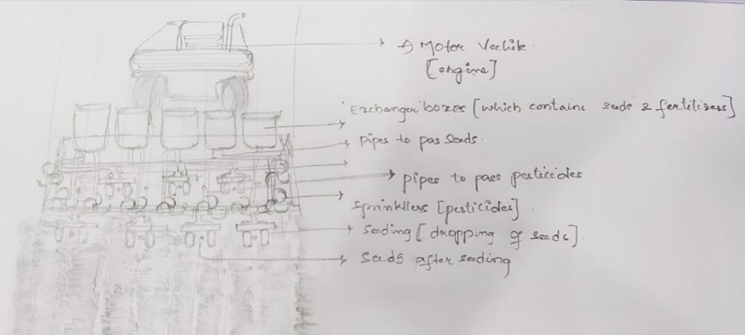
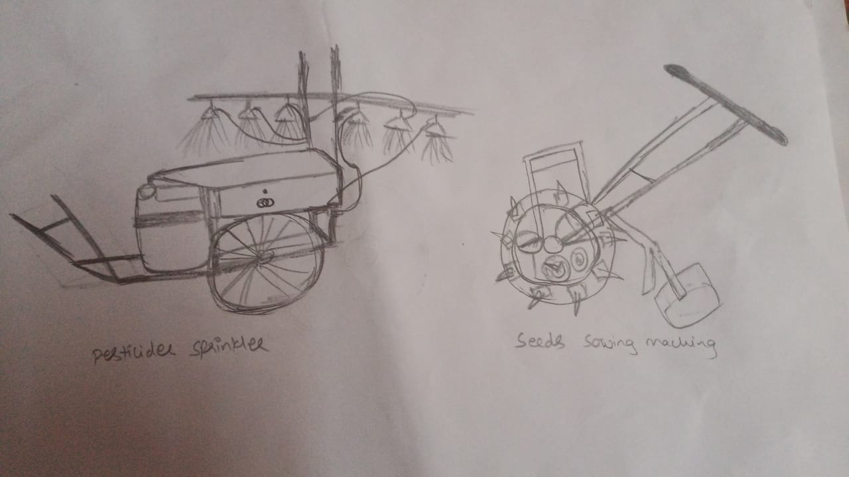
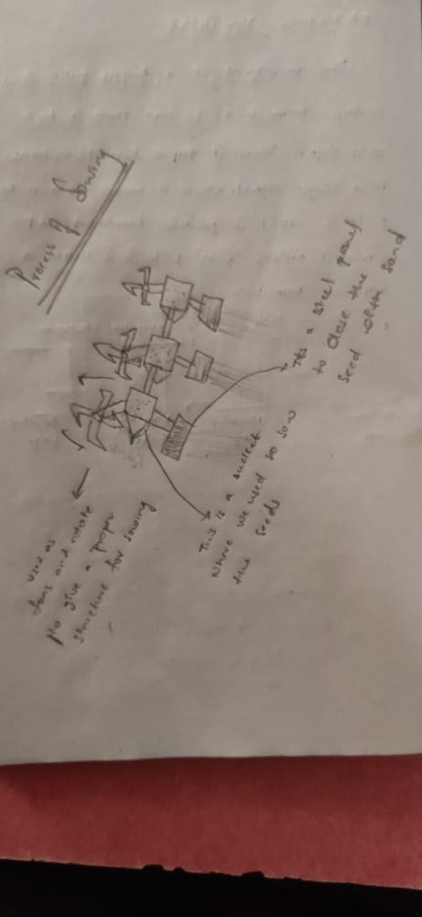
All concepts of team members :

Slide 10
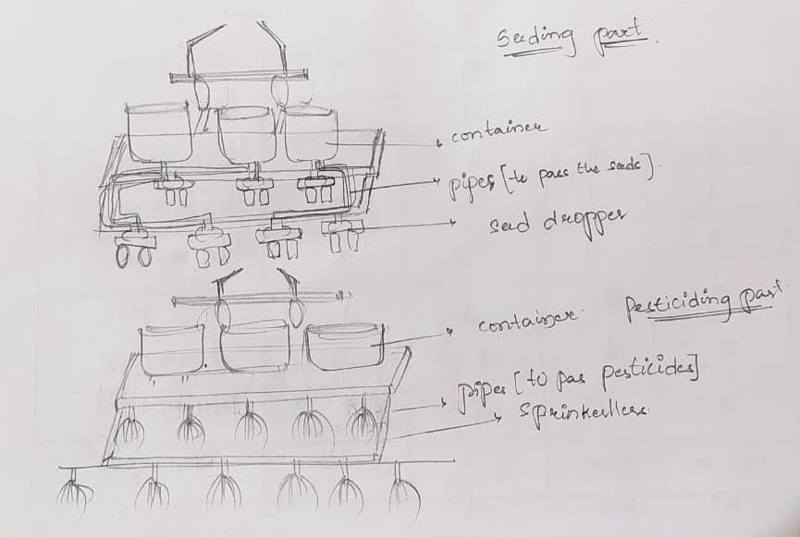
CONCEPT DEVELOPMENT:

Slide 11
ANALYSIS-
: the working of the product totally explains about the simple mechanism of ploughing soil and showing seeds when there is movement of the vehicle the plough share and close shaft present at the bottom of the vehicle is used for ploughing the soil and combining the ringside is a collection of pipes from the container box located at top of the ground a whole is made to the box and seats are stored in it as a vehicle moves forward we can observe the flow of seats from top to bottom also the left over soil covers the seats by itself thus the moment of vehicles explains the ploughing of soil and simultaneous seed showing end covering the soil.

Slide 12
RESULTS
Results: the user is completely and perfectly happy with the product which we have produced that is in brackets fabricated. As we have framed product as per the desire and comfort of the user, the user is happy on testing and working on it. The user tells that this product will definitely reduce the stress and pain physically, and the user also explain claim that on using this product can increase their earnings fruitfully in their livelihood. There our product will definitely be helpful to the end user

Slide 13
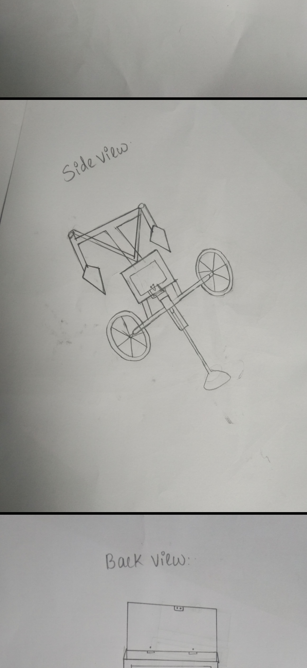
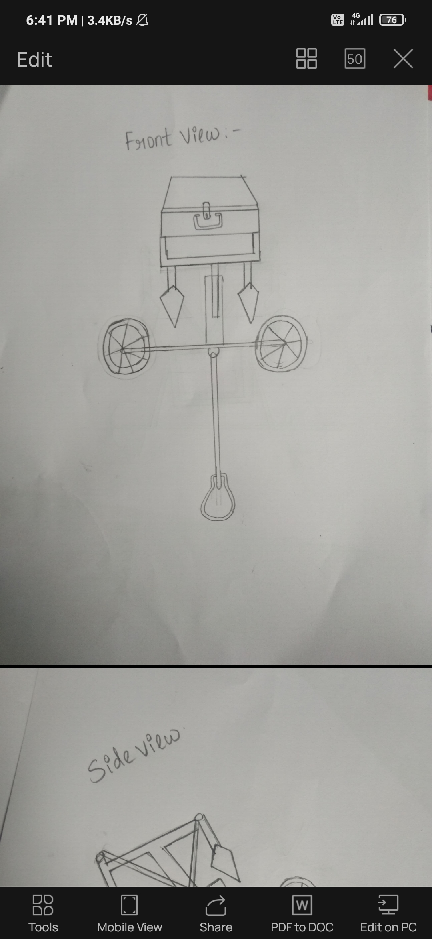
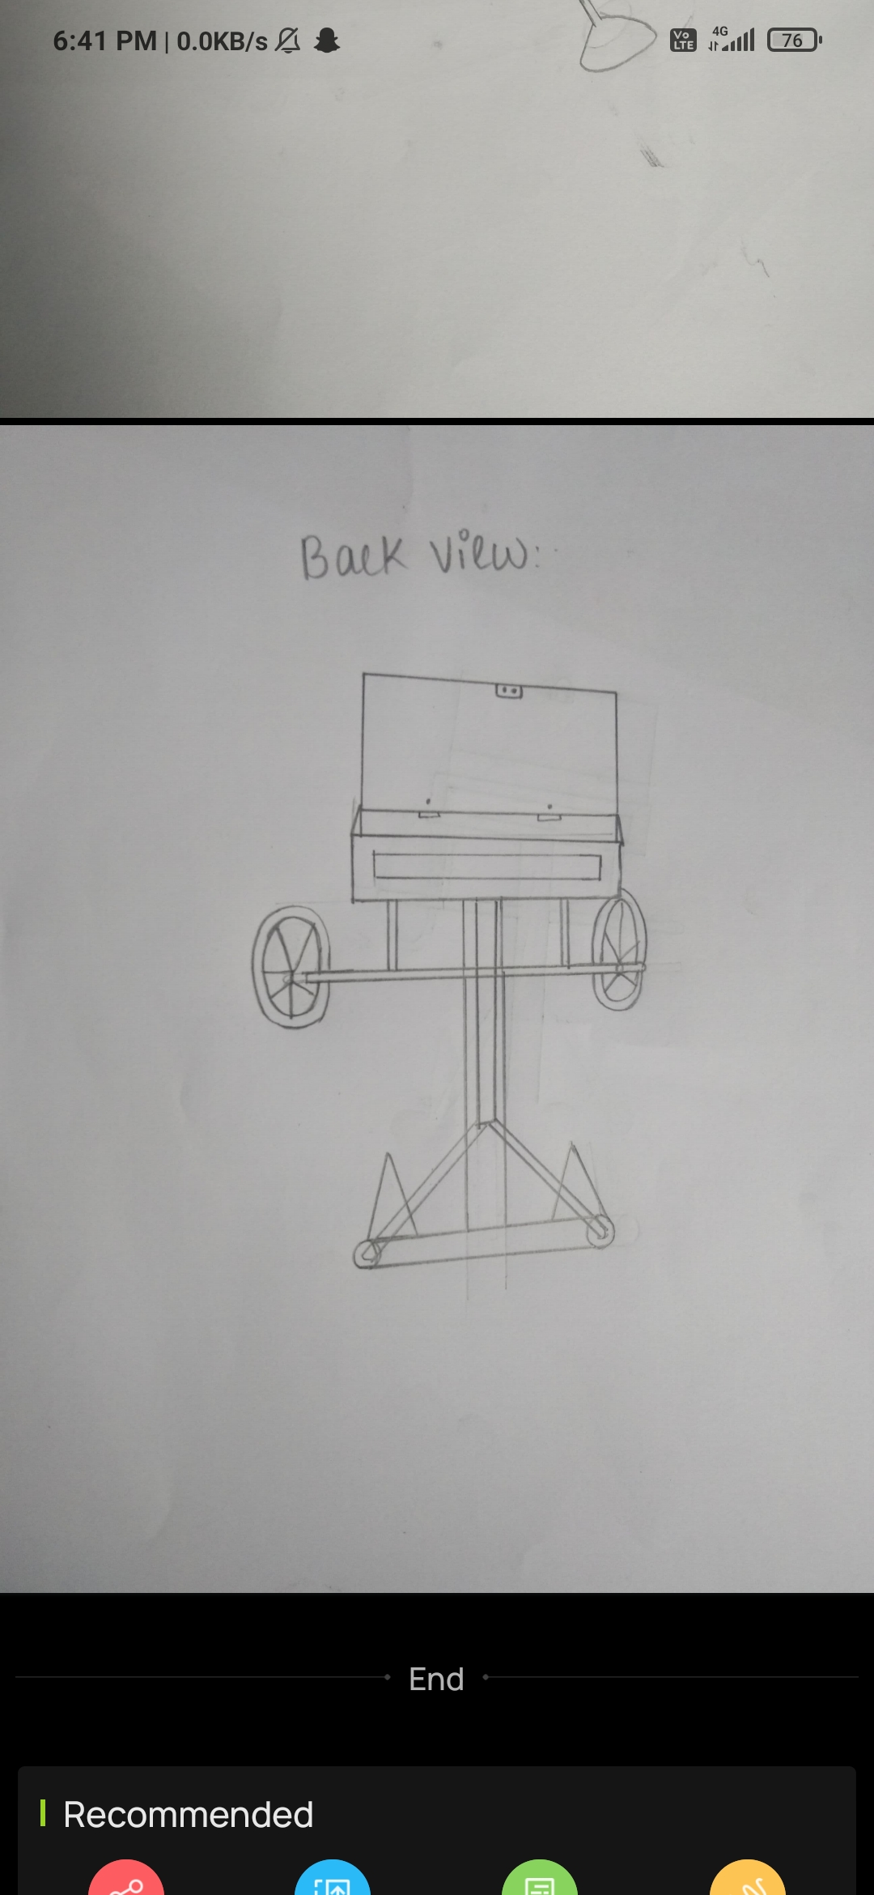
FINAL PRODUCT SKETCH

Slide 14
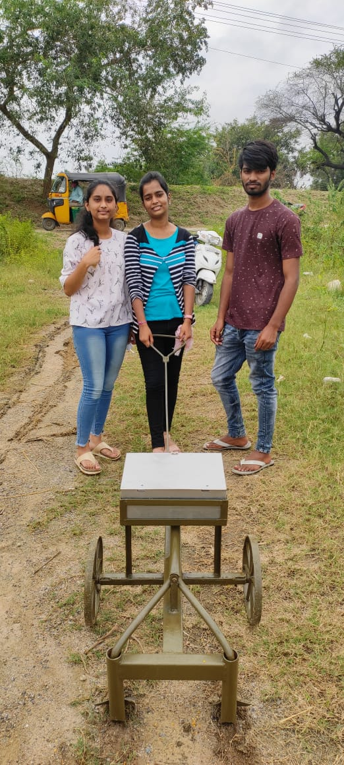
WORKING TEST-

Slide 15
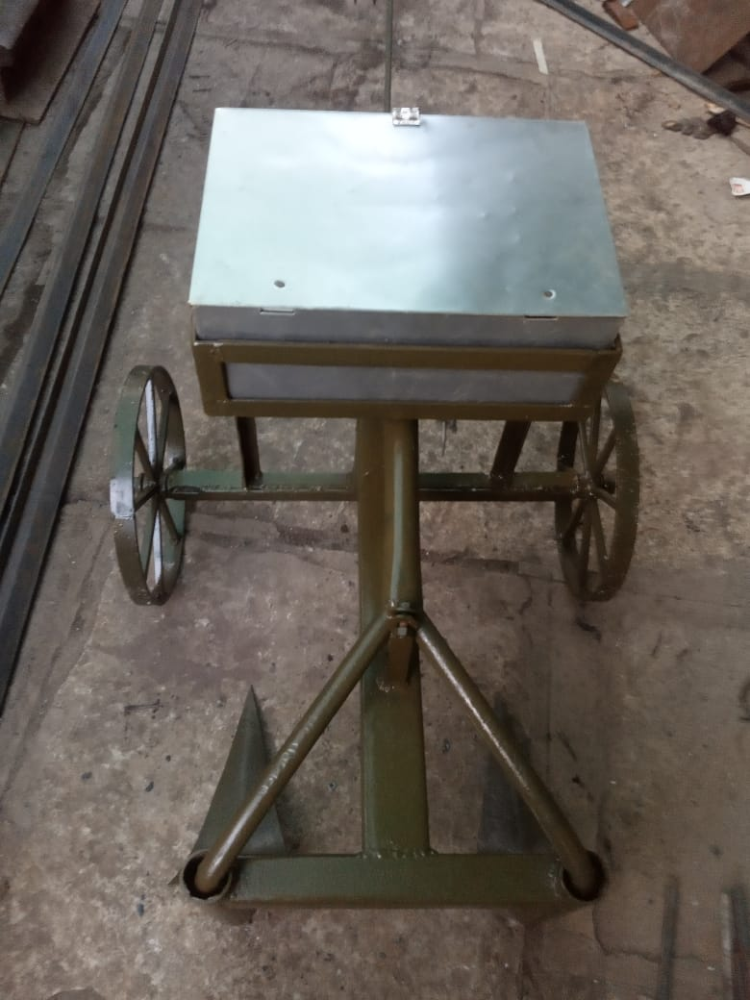
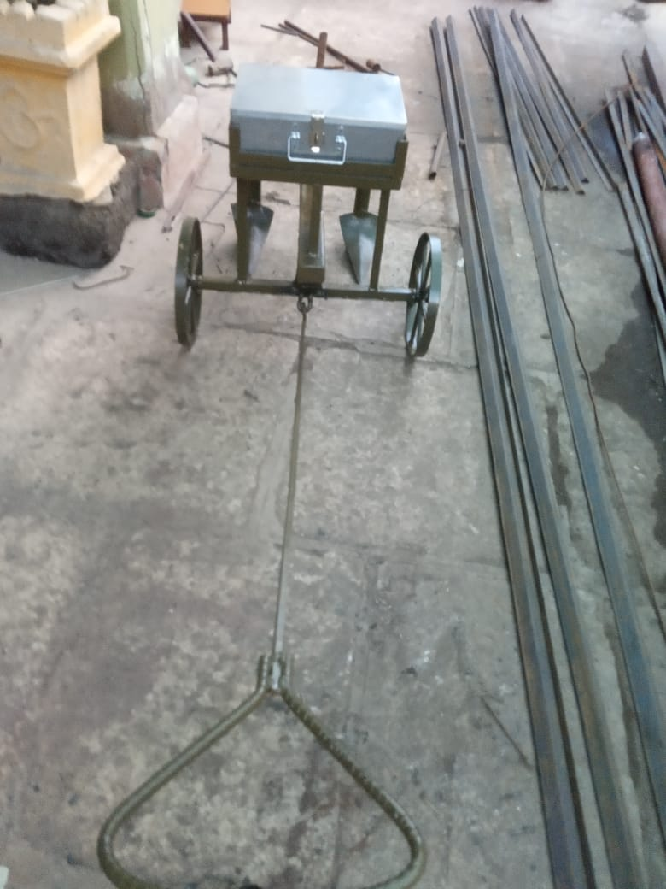
FINAL PRODUCT IMAGE-

Slide 16
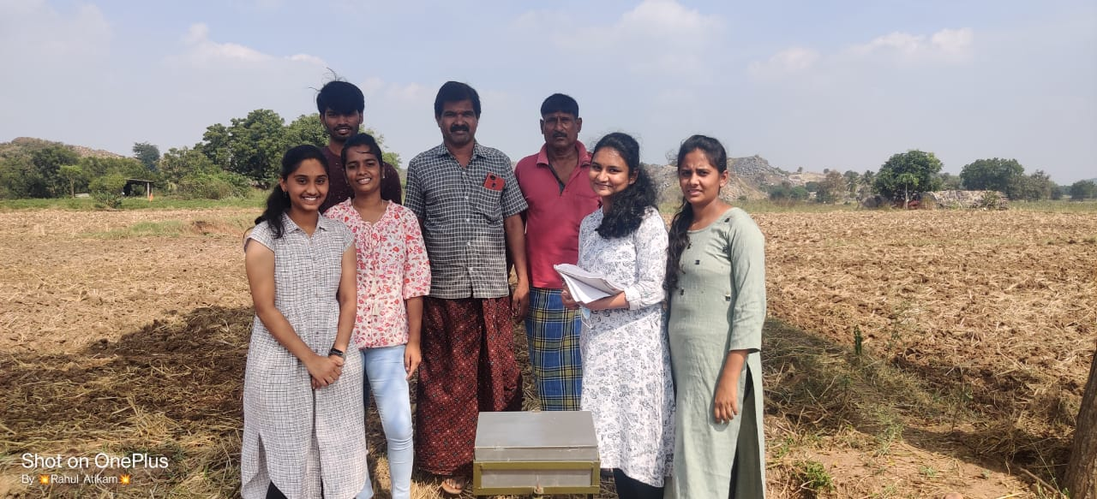
USER TESTING IMAGE-

Slide 17
USER TESTING VIDEO-
https://drive.google.com/folderview?id=1gTZ7CWaTtb9hUDFuOFDojpHc1iuMtpuJ

Slide 18
Budget Caluculation
S.no | Name of the component | Quantity | Unit price | Amount
1 | Exchanger box | 3 | 2000 | 6000
2 | Seeding wheels | 5 | 750 | 1500
3 | Pesticide sprayer | 8 | 187 | 1500
4 | Metal rods of fencing | 12 | 90 | 1080
5 | Connecting pipes | 13 | 100 | 1300
6 | Containers | 3 | 100 | 300
7 | Engine | 1 | 500 | 500 TOTAL = 12,180/-

Slide 19
CONCLUSION:
The user can easily sow the cotton seed and sprinkle the pesticides without any physical effort.
This product reduces the time for the user
This also reduces the number of the labourers required.
In a situation , that we cant afford farmers this machine makes the work happen without stop in middle.
One machine has a capacity of covering 2-3 acres of land if once started. So therefore, this makes the work easier.
The budget Is friendly for the farmers economy.
product is ecofriendly in nature and doesnt harm the user.

Slide 20
Work plan (Gantt chart)
(step by step process till reaching POC)
Tasks | Week 1 | Week 2 | Week 3 | Week 4 | Week 5 | Week 6 | Week 7
Observations
Ethnographic survey
Need analysis
Concept generation
Designing sketches
Prototype

Slide 21
Questions??????

